Slide 1




Web Sockets
Eyal Vardi
CEO E4D Solutions LTD Microsoft MVP Visual C# blog: www.eVardi.com

Slide 2
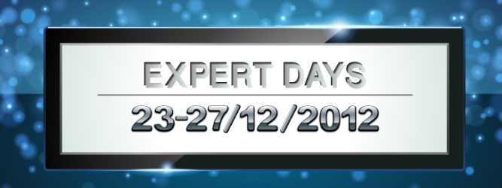
Agenda
Type of Communications
Web Sockets API’s

Slide 3
Type of Communications

Slide 4
Periodic polling
Server
Poll from time to time using Ajax
Delay in communications due to polling interval
Wastes bandwidth & latency ☹
Client
Polling interval

Slide 5
Long polling
Server
Poll but don’t respond untill there’s data
Poll again after data received or after the connection times out
Consumes server threads & connection resources ☹
Client

Slide 6
Forever Frame
Server
HTTP/1.1 200 OK Content-Type: text/plain Transfer-Encoding: chunked
Server tells client that response is chuncked
Client keeps connection open untill server closes it
Server pushes data to the client followed by \0
Consumes server threads
<script>eval("... ")</script>\0
Client
<script>eval("... ")</script>\0

Slide 7
WebSockets

Slide 8

What is WebSockets?
WebSocket is a web technology providing for bi-directional, full-duplex communications channels over a single TCP connection.
the communications are done over the regular TCP port number 80 or 443.
ws:// and wss:// prefix to indicate a WebSocket and a WebSocket Secure connection, respectively.

Slide 9
WebSocket Protocol Handshake
To establish a WebSocket connection, the client sends a WebSocket handshake request, and the server sends a WebSocket handshake response.
GET /mychat HTTP/1.1
Host: server.example.com
Upgrade: websocket
Connection: Upgrade
Sec-WebSocket-Key: x3JJHMbDL1EzLkh9GBhXDw==
Sec-WebSocket-Protocol: chat
Sec-WebSocket-Version: 13
Origin: http://example.com
Client
Server
HTTP/1.1 101 Switching Protocols
Upgrade: websocket
Connection: Upgrade
Sec-WebSocket-Accept: HSmrc0sMlYUkAGmm5OPpG2HaGWk=
Sec-WebSocket-Protocol: chat

Slide 10
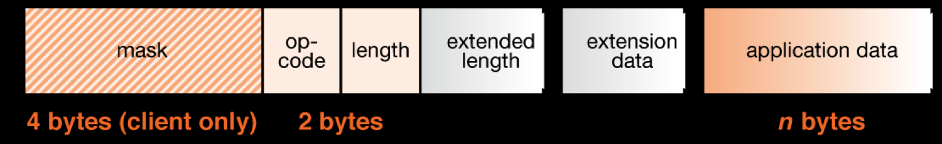
WebSocket Protocol Handshake
WebSocket data frames can be sent back and forth between the client and the server in full-duplex mode.
Both text and binary frames can be sent in either direction at the same time.
The data is minimally framed with just two bytes. In the case of text frames, each frame starts with a 0x00 byte, ends with a 0xFF byte, and contains UTF-8 data in between.
WebSocket text frames use a terminator, while binary frames use a length prefix.

Slide 11
HTML5 WebSocket API
var myWebSocket = new WebSocket("ws://www.websockets.org");
myWebSocket.onopen = function(evt) { alert("Connection open ..."); }; myWebSocket.onmessage = function(evt) { alert("Received Message: " + evt.data); }; myWebSocket.onclose = function(evt) { alert("Connection closed."); }
myWebSocket.send("Hello WebSockets!"); myWebSocket.close();

Slide 12

Web Socket Echo (http://www.websocket.org/echo.html)

